Slide 1
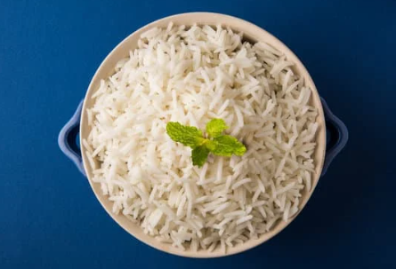
Rice Image Classification
Chandan Saha – Intro to Deep Learning Final Project

Slide 2
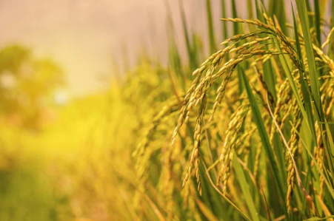
INTRODUCTION
EDA
ARCHITECHTURE
ANALYSIS
CONCLUSION

Slide 3
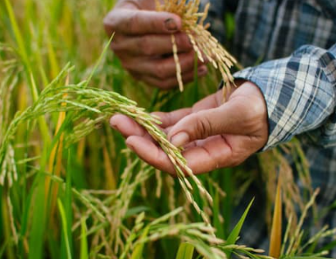
Introduction
In this study we are looking at 5 different varieties of rice grown in turkey. They are Arborio, Basmati, Ipsala, Jasmine and Karacadag.
There are a total of 75,000 grain images, 15,000 from each variety are included in the dataset.
Our job is to use the Neural Network to correctly classify the type of rice, given the picture.

Slide 4
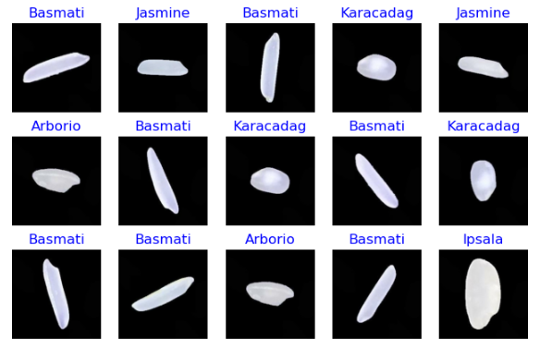
EDA
Separate our data into the training and the test data. Of the 75,000 pictures, we take 60,000 for training and leave 15,000 as test data.
Ensure all the pictures are the same size
Take a look at the individual pictures
Random 15 pictures printed from the training data with their respective labels.

Slide 5
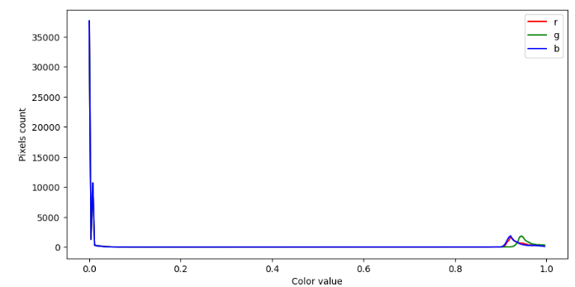
EDA
Picture are JPG so there are RBG values.
Plot and look at the RGB values for the pictures.
RGB values shows us that there is very little color in our pictures. This is also shown by looking at the individual ice pictures. .

Slide 6
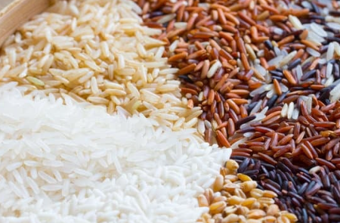
Architecture

Slide 7
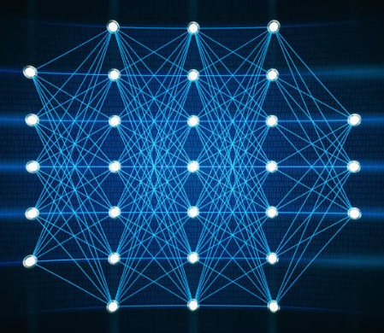
Convolutional Neural Networks
The design of CNNs is well-suited to the properties of natural images. They can effectively learn hierarchical representations of images, where the early layers capture local, simple features and the later layers capture global, complex features. Therefore, they have become the standard architecture for many tasks in image processing, including image classification.

Slide 8
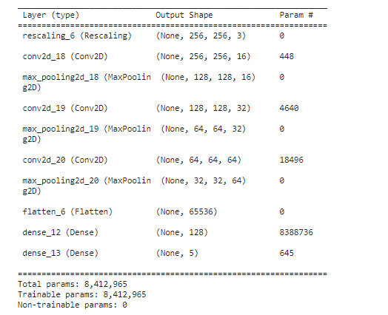
Layers
Model type is Sequential since it is the easiest way to build a model in Keras.
Our first two layers are Conv2D layers that will deal with our input images, which are seen as 2-dimensional matrices. The Kernel size is 3 which means we will have a 3x3 filter matrix.
We will be using ReLU activation since it works well in neural networks.
In between the Conv2D layers and the dense layer, there is a flatten later. Flatten serves as a connection between the convolution and dense layers.

Slide 9
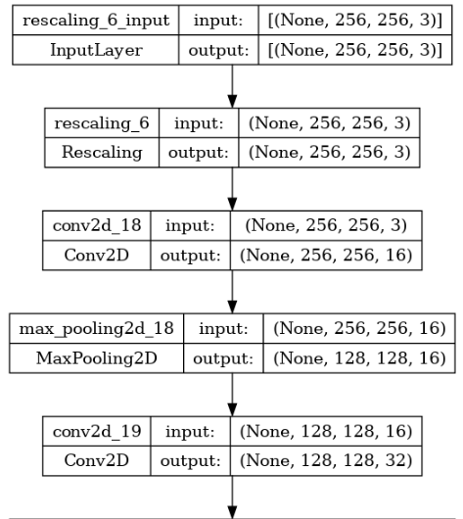
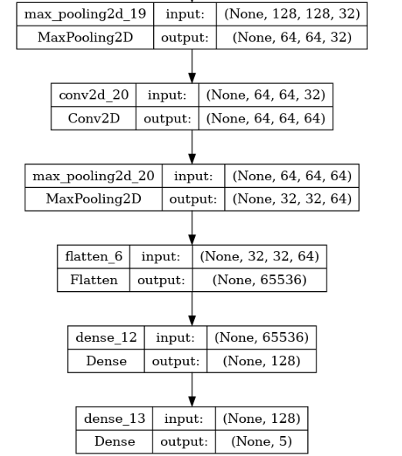
Layers
The rescaling layer transforms our RGB values which typically range from 0 to 255 to values between 0 and 1.
We do not use any padding in our convolution layers.
We have 3 MaxPooling2D layers in order to reduce the spatial size (width and height) of the input volume for the next layer.
This helps our model learn more efficiently.

Slide 10
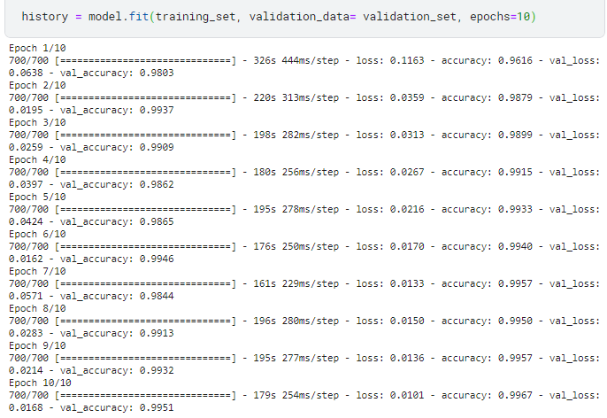
Training the Model
Creating training and validation sets from the training data.
Running our model on this data for 10 epochs.

Slide 11
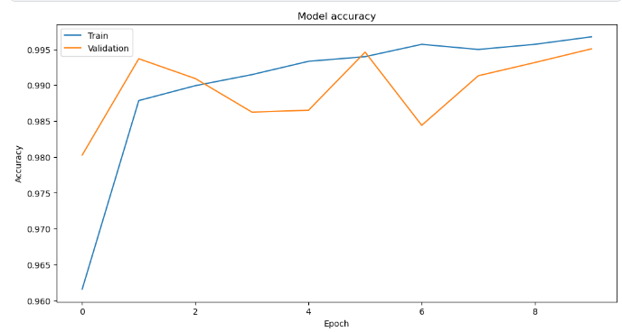
Visualizing the Training
Looking at the model accuracy and the validation accuracy through the epochs

Slide 12
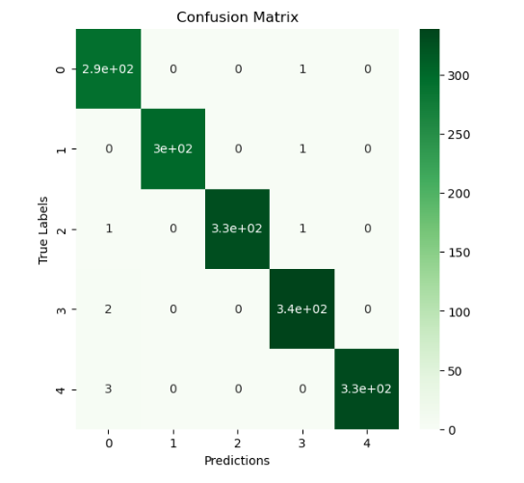
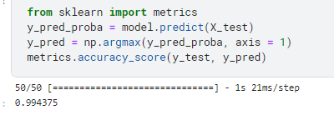
Evaluation
Our CNN model performed very well on the test data with an accuracy of 99.4375%
Confusion Matrix of our model’s performance vs the Test Data

Slide 13
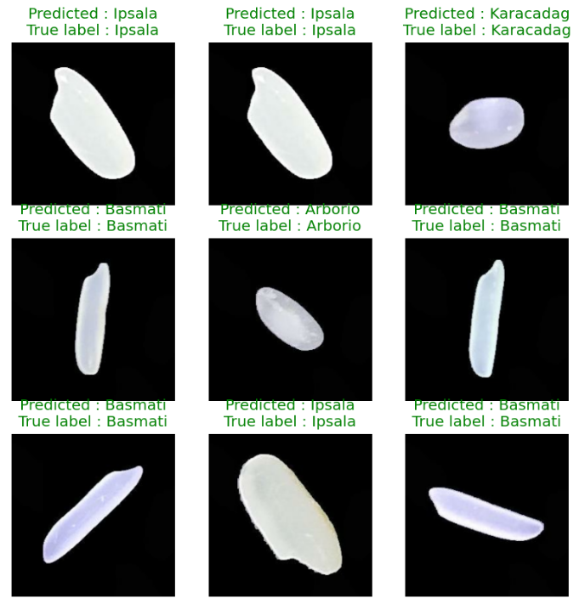
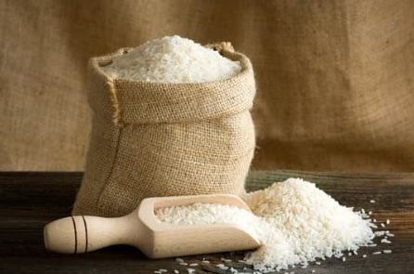
Sample Predictions
Random sampling of the predictions made by our model on the test set. Visualized.

Slide 14
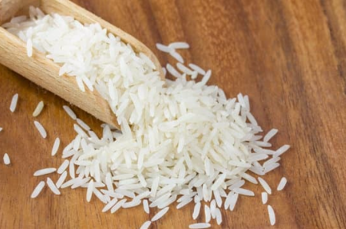
Conclusion
Our Model performed really well! But could it be even better? Some steps we can take include:
Adding more convolutional layers (affects performance)
Adding a Dropout Layer to prevent possible overfitting
Can tune the hyperparameters such as Conv2D (strides, padding, activation method)
Use different batch sizes

Slide 15

Thoughts
Run-Time
While it is ideal to test and experiment with our hyperparameters, the time to run and train the model each time was a hindrance since we are limited to 30 Hours of GPU compute on Kaggle. If I were to do this again, I would consider the following:
Training the model offline or someplace with greater GPU processing power.
Training the model somewhere where I would not be constrained by compute time.
Waiting
Time spent waiting for computes to run really hindered my enthusiasm for this project.
I would prefer to do machine learning projects where I would not have to wait so long for the models to get trained.

Slide 16
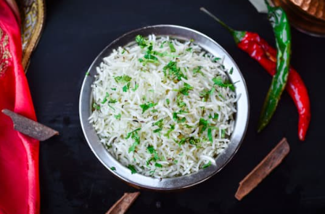
References and Links
Keras for Beginners: https://victorzhou.com/blog/keras-cnn-tutorial/
Rice Image Dataset: https://www.kaggle.com/datasets/muratkokludataset/rice-image-dataset
CNN Keras: https://www.kaggle.com/code/vincee/intel-image-classification-cnn-keras
Personal Github: https://github.com/Chanksyou/Rice-Image-Classification

Slide 17
thank you
Chandan Saha
https://github.com/Chanksyou/
Intro to Deep Learning Final Project

